Slide 1
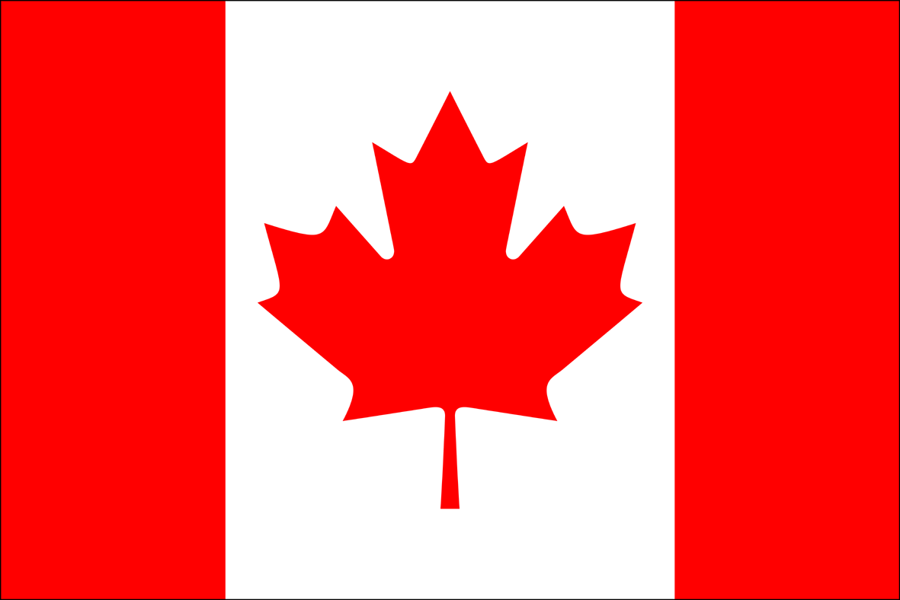
CANADA

Slide 2
CANADA
it is the world's second largest country by total area (9 984 670 km²)
capital is Ottawa, the largest city is Toronto
it is federation that is governed as a parliamentary democracy and a constitutional monarchy (Queen Elizabeth II.)
official languages are English and French
population: 34 019 000 people (1. 4. 2010)

Slide 3
HISTORY
human presence from 26 500 years ago (in the northern Yukon)
first Europeans were Norse sailors in Newfoundland around 1000 AD
in 1497 Italian seafarer John Cabot explored Canada's Atlantic coast for England
the first permanent European settlements were at Port Royal (1605) and Quebec City – French colonies
English established the Thirteen Colonies to the south in Canada in 1610
the Constitution Act officially proclaimed Canadian Confederation on 1. 7. 1867

Slide 4
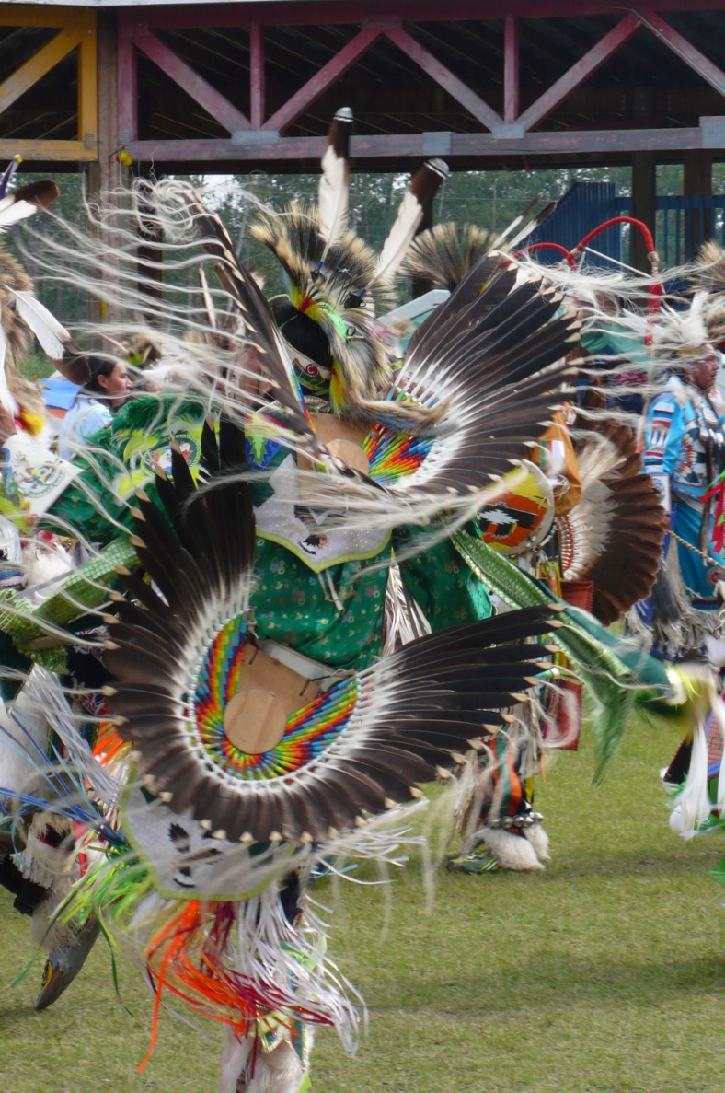
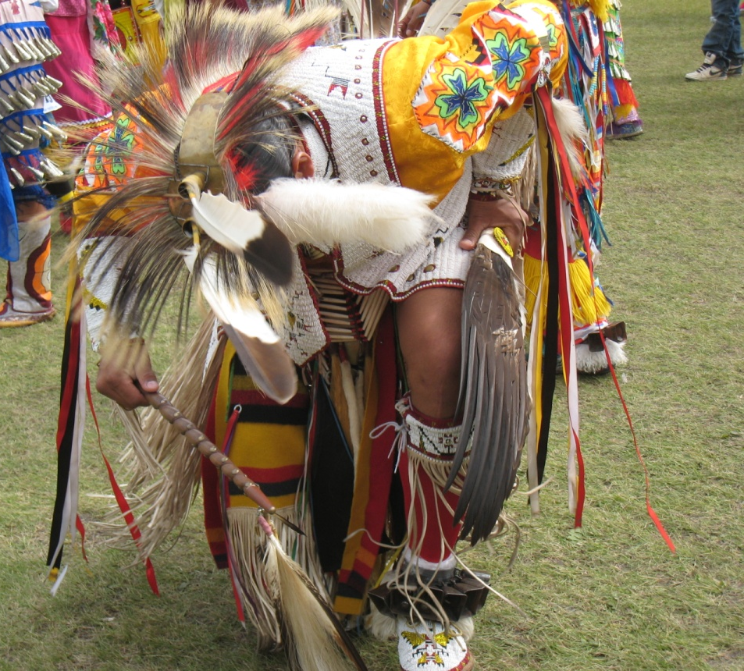
Natives
First Nations (700 000 people)
Inuit
Métis (300 000 people)

Slide 5
Provinces and territories
Canada is a federation composed of ten provinces and three territories
Alberta, British Columbia, Saskatchewan, Manitoba, Ontario, Quebec, Newfoundland and Labrador, Prince Edward Island, Nova Scotia, New Brunswick
Yukon, Northwest Territories, Nunavut

Slide 6
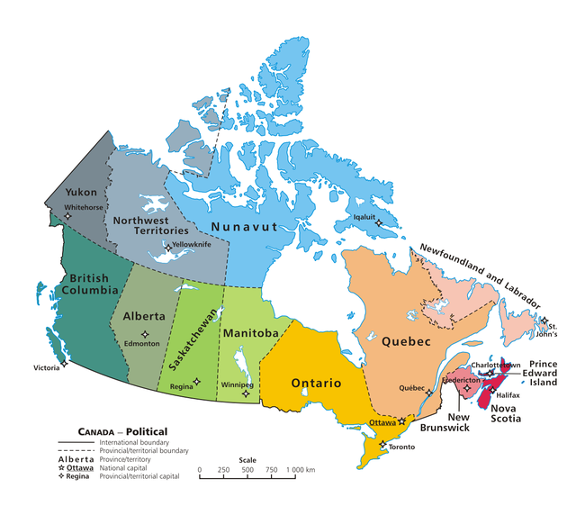

Slide 7
Ethnic origin
Canadian (32%), English (21%), French (15,8%), Scottish (15,1%), Irish (13,9%), German (10,2%), Italian (4,6%), Chinese (4,3%), North American Indian (4,0%), Ukrainian (3,9%), and Dutch (Netherlands) (3,3%).
there are 600 recognized First Nations governments or bands encompassing
1 172 790 people

Slide 8
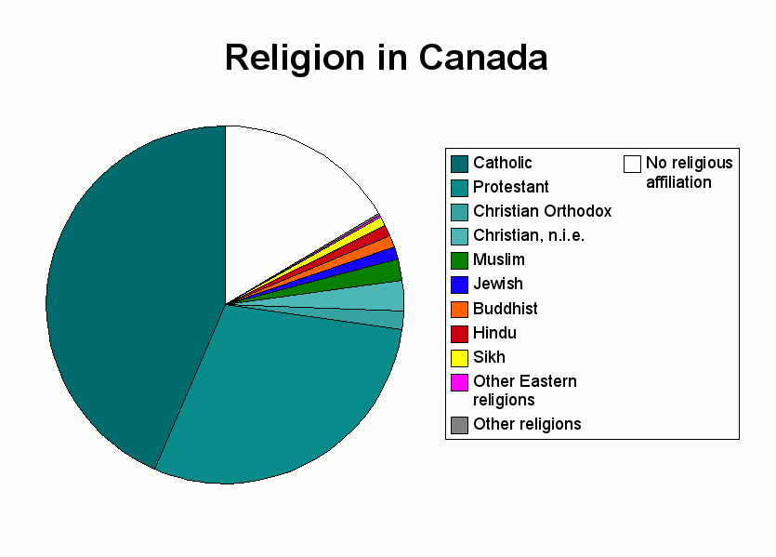
16, 5%
- 1,5 %
- 2,6 %
- 2,0 %
- 1,1 %
43, 6%
- 1,0 %
- 1 ,0 %
- 0,9 %
29, 2%

Slide 9
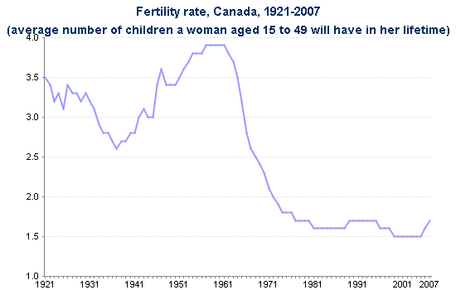
Fertility rate

Slide 10
Special holidays
1. 7. – Canada Day (celebrates Canada's 1867 Confederation and establishment of dominion status)
First Monday in September – Labour Day (celebrates economic and social achievements of workers)
Monday on or before May 24 – Victoria Day (celebrates the birthday of the reigning Canadian monarch)
Second Monday in October – Thanksgiving Day (a day to give thanks for the things one has at the close of the harvest season)
11. 11. – Remembrance Day (commemorates Canada's war dead. Anniversary of the armistice ending World War I in 1918)
26. 12. – Boxing Day

Slide 11
Cuisine
BBQ
Yellow pea soup
ginger beef/pop
maple syrup
apple/pumpkin pie
donuts
bagels
cheesecake

Slide 12
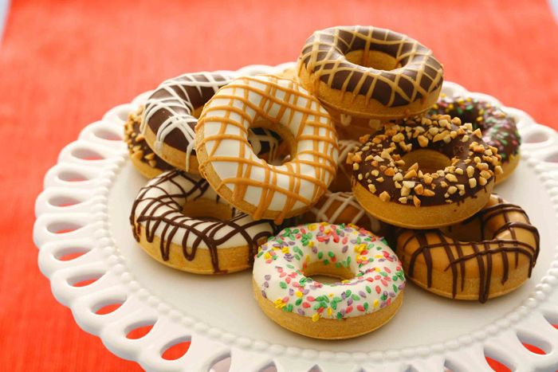
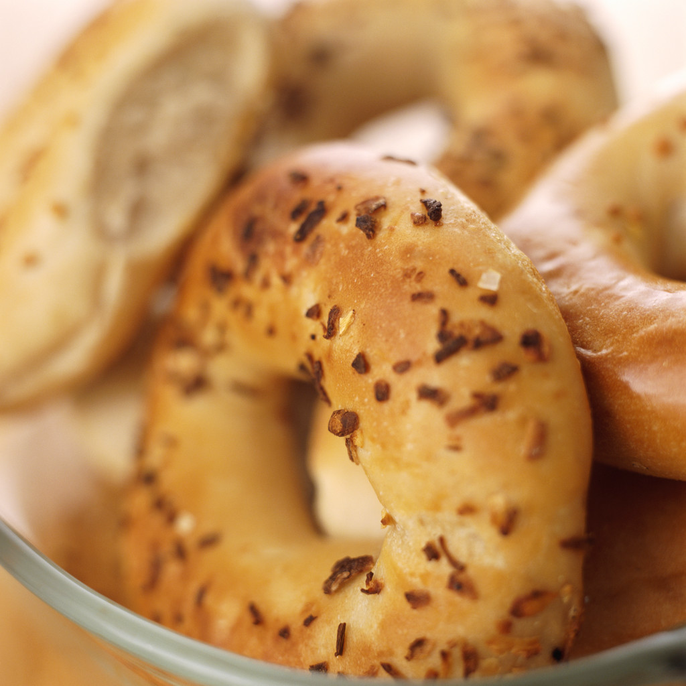
bagels
donuts

Slide 13
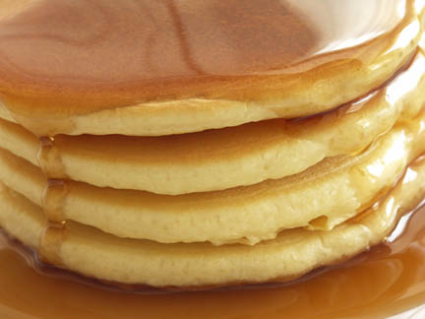
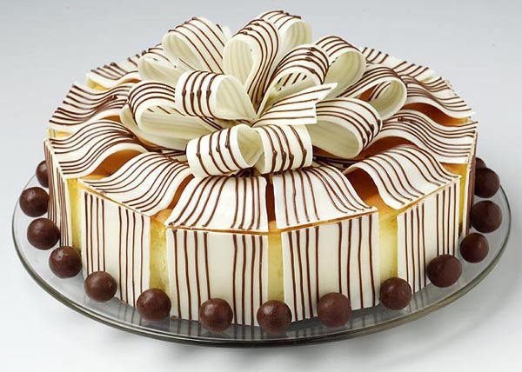
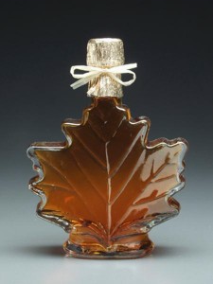
cheesecake
maple syrup

Slide 14
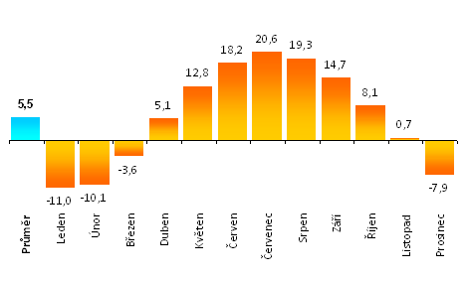
Climate
°C
in Ottawa (south part of Canada)

Slide 15
Nature
many lakes of glacial origin, islands and glaciers
many tipe of climate: the Arctic, the tundra with coniferous forests, prairies and deciduous forests
many animals: elk, bear, ovibovine, beaver, fox, moose, bison

Slide 16
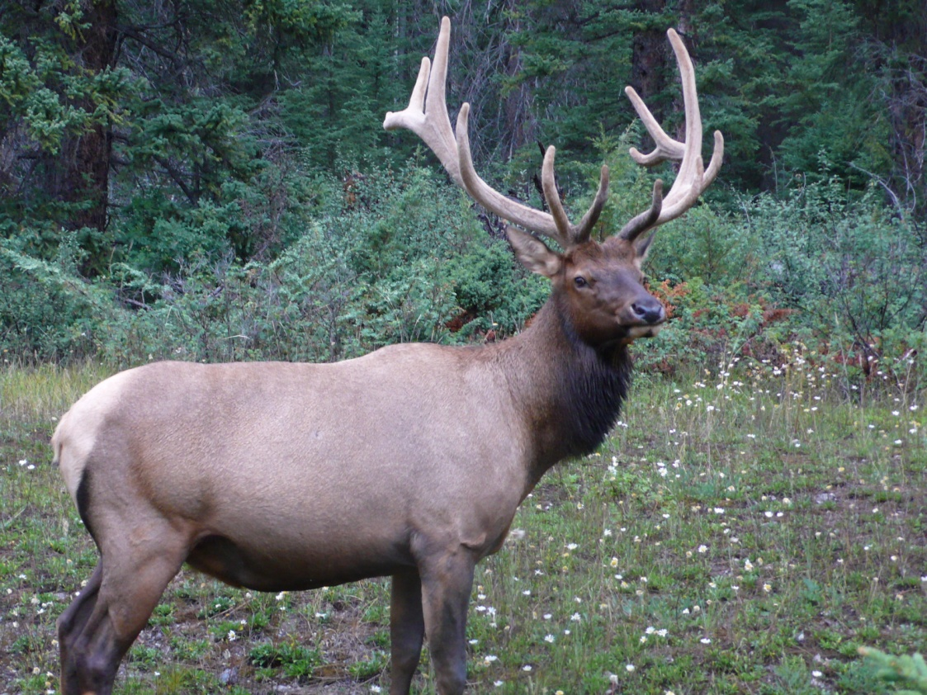
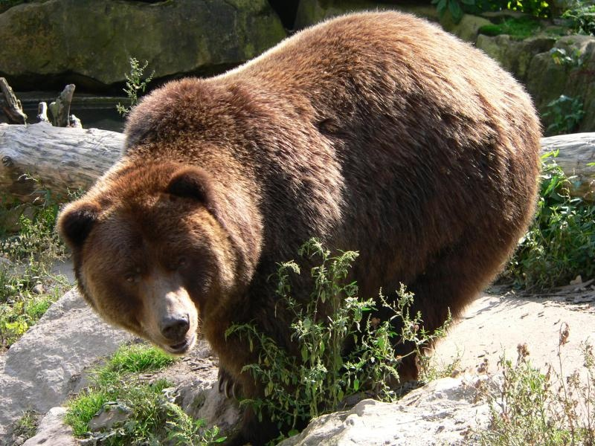
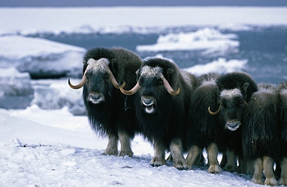
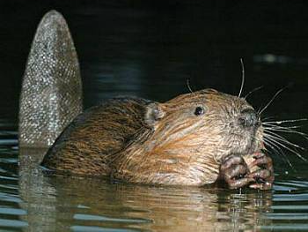

Slide 17
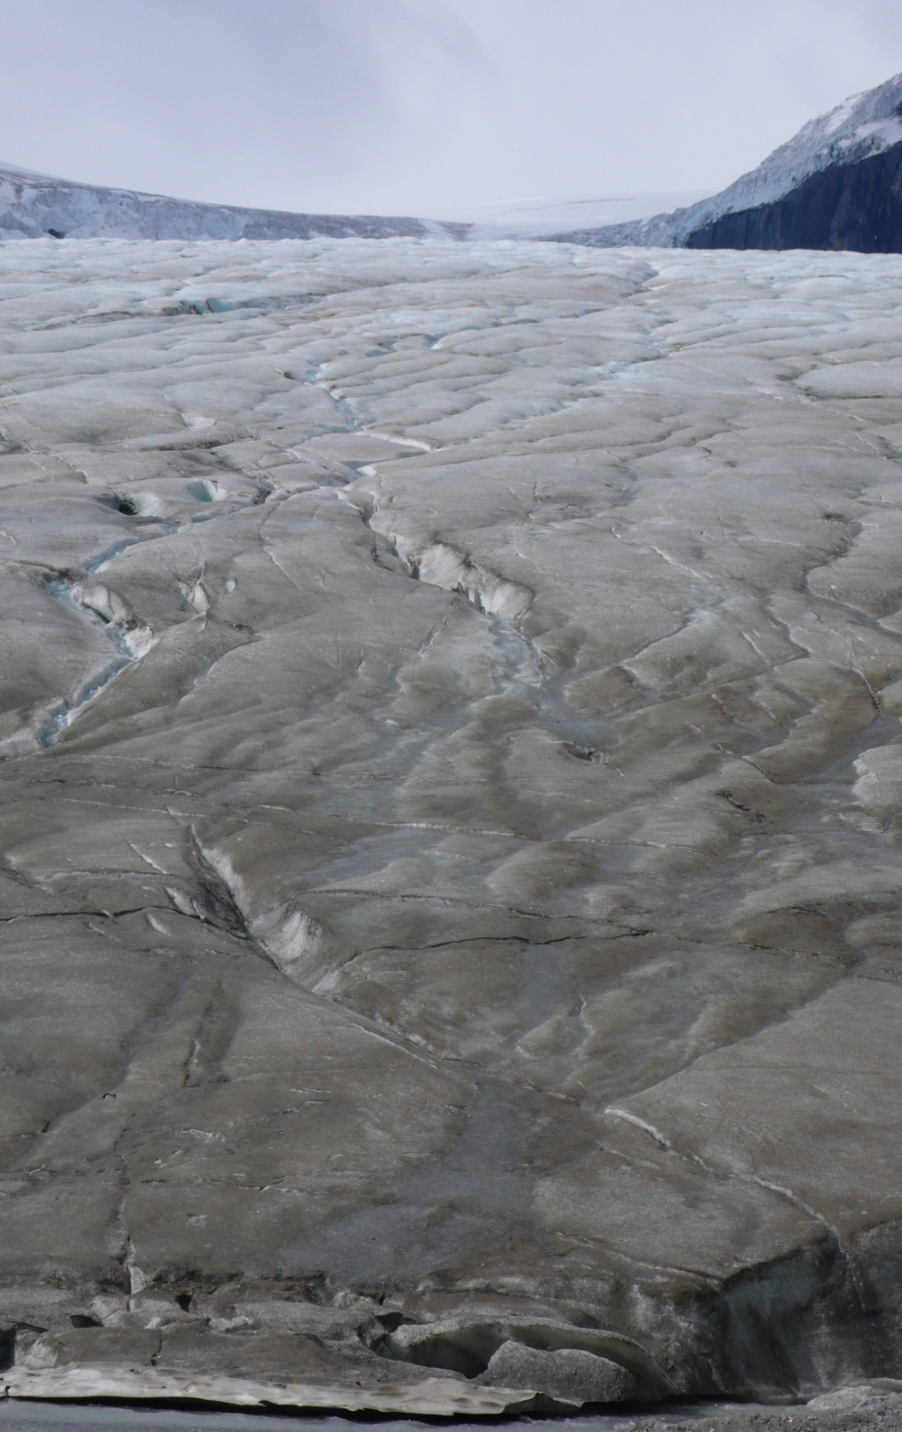
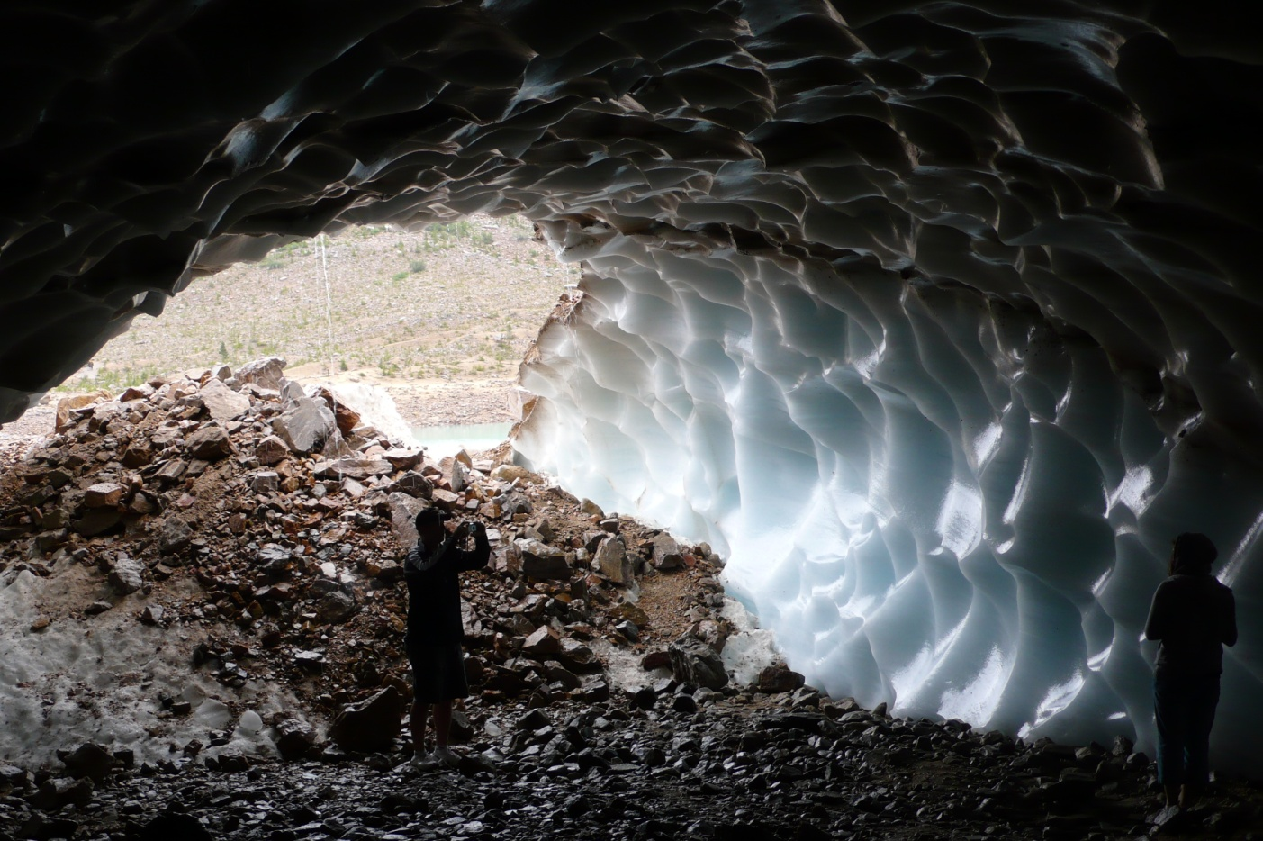
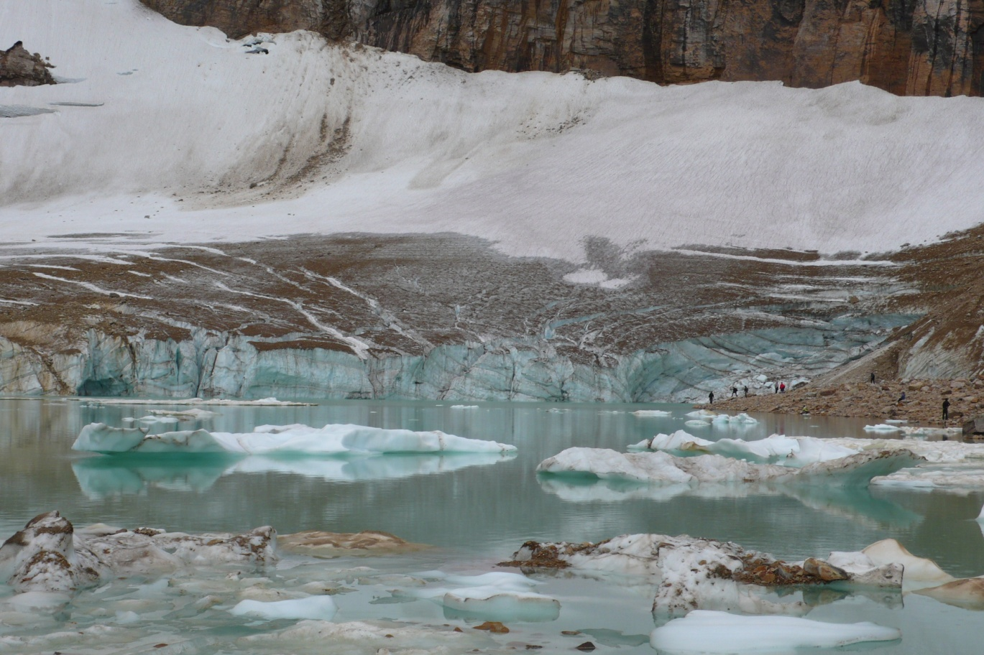

Slide 18
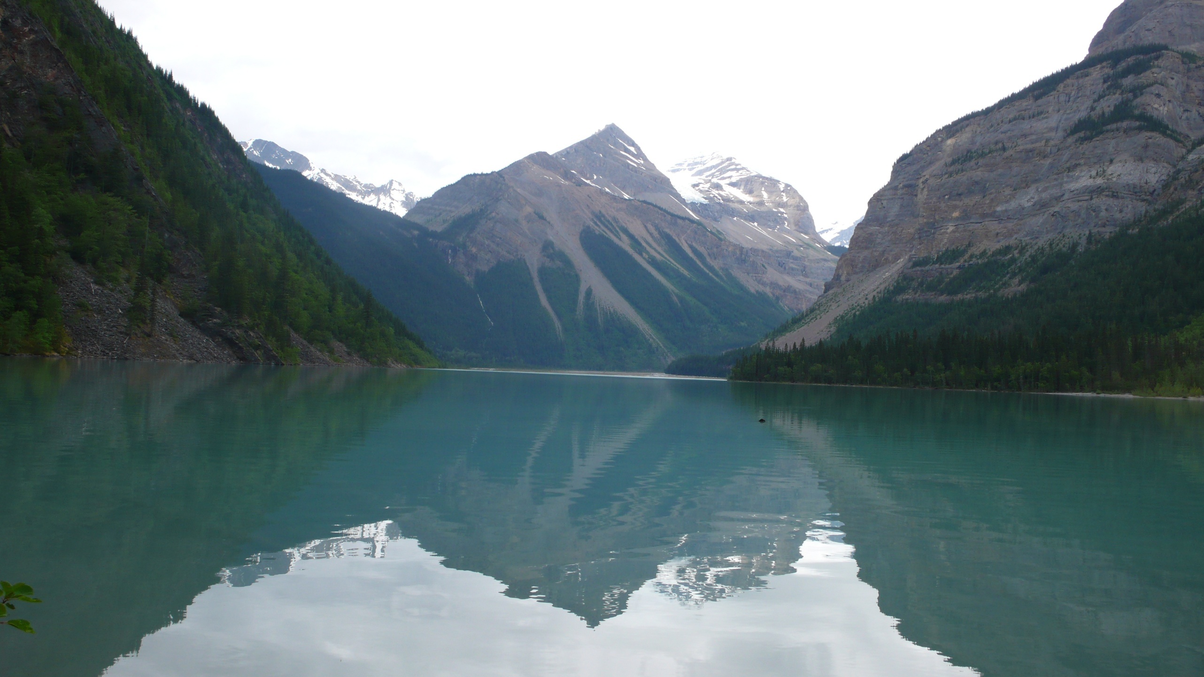

Slide 19
